Slide 1

ABAP integration – a recent case study
Graham Robinson
Yelcho Systems Consulting

Slide 2




Introduction
@grahamrobbo
*Photo by Martin Gillet

Slide 3
Agenda
Enterprise Content Management
Customer #1
Customer #2
Project #1 – Early Archiving of Invoices
Project #2 – Late Archiving of Invoices
Project #3 – Extranet
Lessons learned

Slide 4
Enterprise Content Management
Documents are unstructured content
Business transactions are structured content and contextual
ECM solutions can link unstructured to structured – thereby providing context to unstructured content e.g. Linking quotation documents to purchase requisition

Slide 5
SAP ArchiveLink
SAP’s service that provides a standard way to store/retrieve documents to/from 3rd party storage repositories whilst maintaining business context
OpenText is a leader in partnering with SAP
But potentially any document repository can support SAP ArchiveLink
There are lots that already do

Slide 6
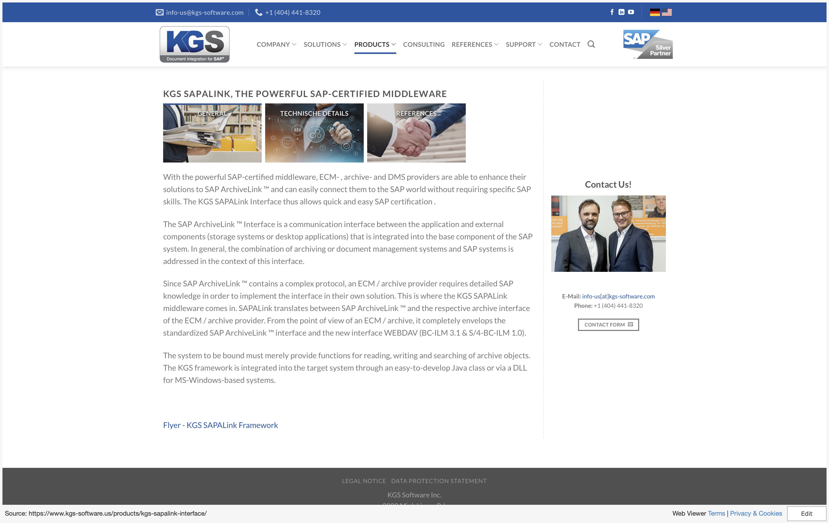
KGS SAP ALINK

Slide 7
KGS

Slide 8
M-Files
Founded in Finland
Local reseller/SI is Upstream

Slide 9
M-Files Concepts
Screenshot to show objects, documents, metadata, relationships, etc.
Workflow design and VBScript handlers

Slide 10
Customer #1
Automotive Industry
Existing relationship via Fuji Xerox
Was chosen as Content Management/Document Management solution across organisation
SAP ArchiveLink feature not licensed
Built ABAP client for M-Files Web Service (REST API)

Slide 11
Customer #2
Automotive Industry
Looking for ECM solution but not wanting to pay “SAP tax”
M-Files chosen in part because of my previous experience with it and the ABAP client that had already been built
SAP ArchiveLink included in license

Slide 12
Project #1
Early Archiving of Vendor Invoices
Upstream led project
Scan/OCR invoice and store in M-Files repository
M-Files workflow to complete invoice details. E.g. account assignments, approvals, etc.
Post Invoice to SAP

Slide 13
Project #1
Original design was for flat file bulk transfers
Other suggestions included making web service calls, ODBC database access, etc.
….

Slide 14
And then a miracle happened….
Mikko Roihuvuo
Developer Evangelist

Slide 15
There is a better way…

Slide 16
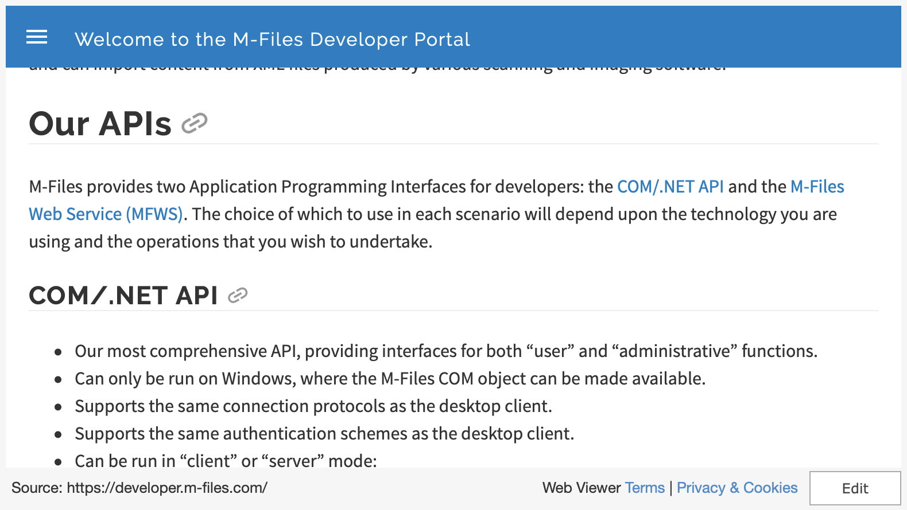

Slide 17
Project #1.1
Post payment details back into M-Files

Slide 18
Project #1.2
Use SAP ArchiveLink to connect SAP Invoice to M-Files source document

Slide 19
Project #2
Late Archiving of Invoices
Used standard SAP ArchiveLink interface
Manipulation of M-Files metadata
SAP BO Container Concept

Slide 20
Project #3 - Extranet

Slide 21
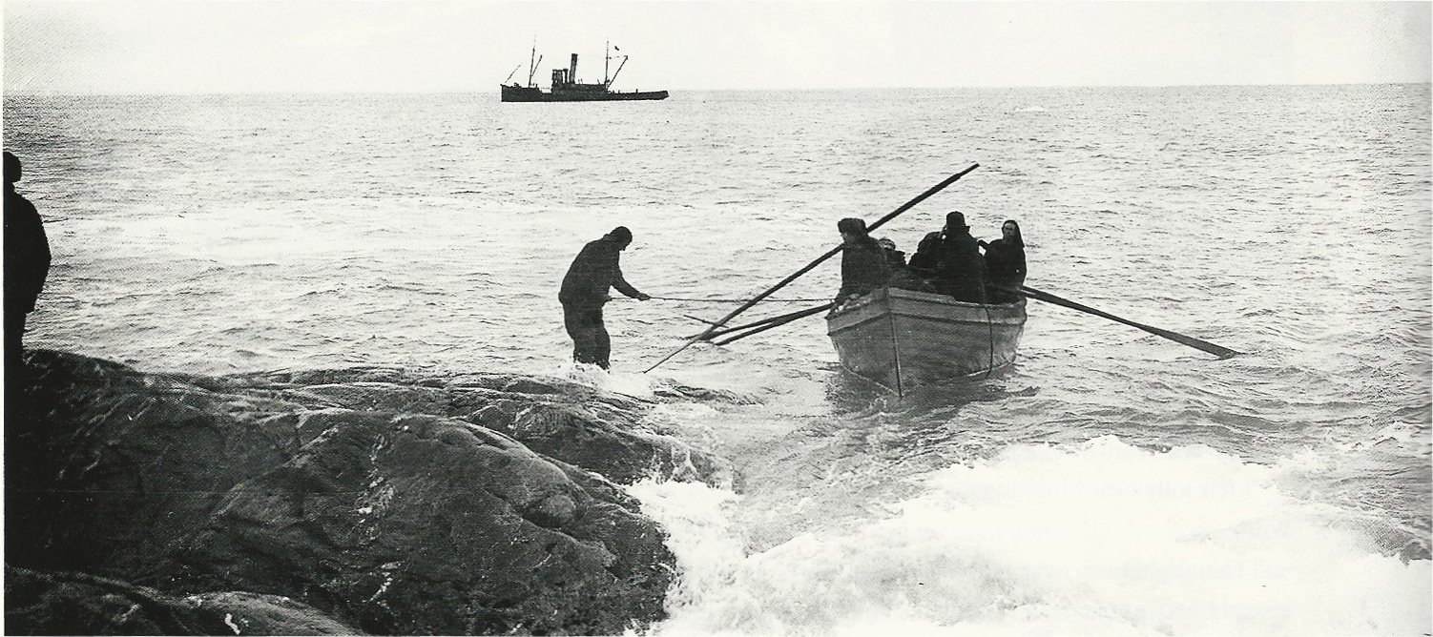


@grahamrobbo

